Slide 1
CFG DEGREE
FULL-STACK
GROUP 4
Susan Bailey, Rana Khoury, Alex Lavin, Joanne Monaghan, and Jemilla Scotten

Slide 2
1.
DEFINE THE PROBLEM

Slide 3
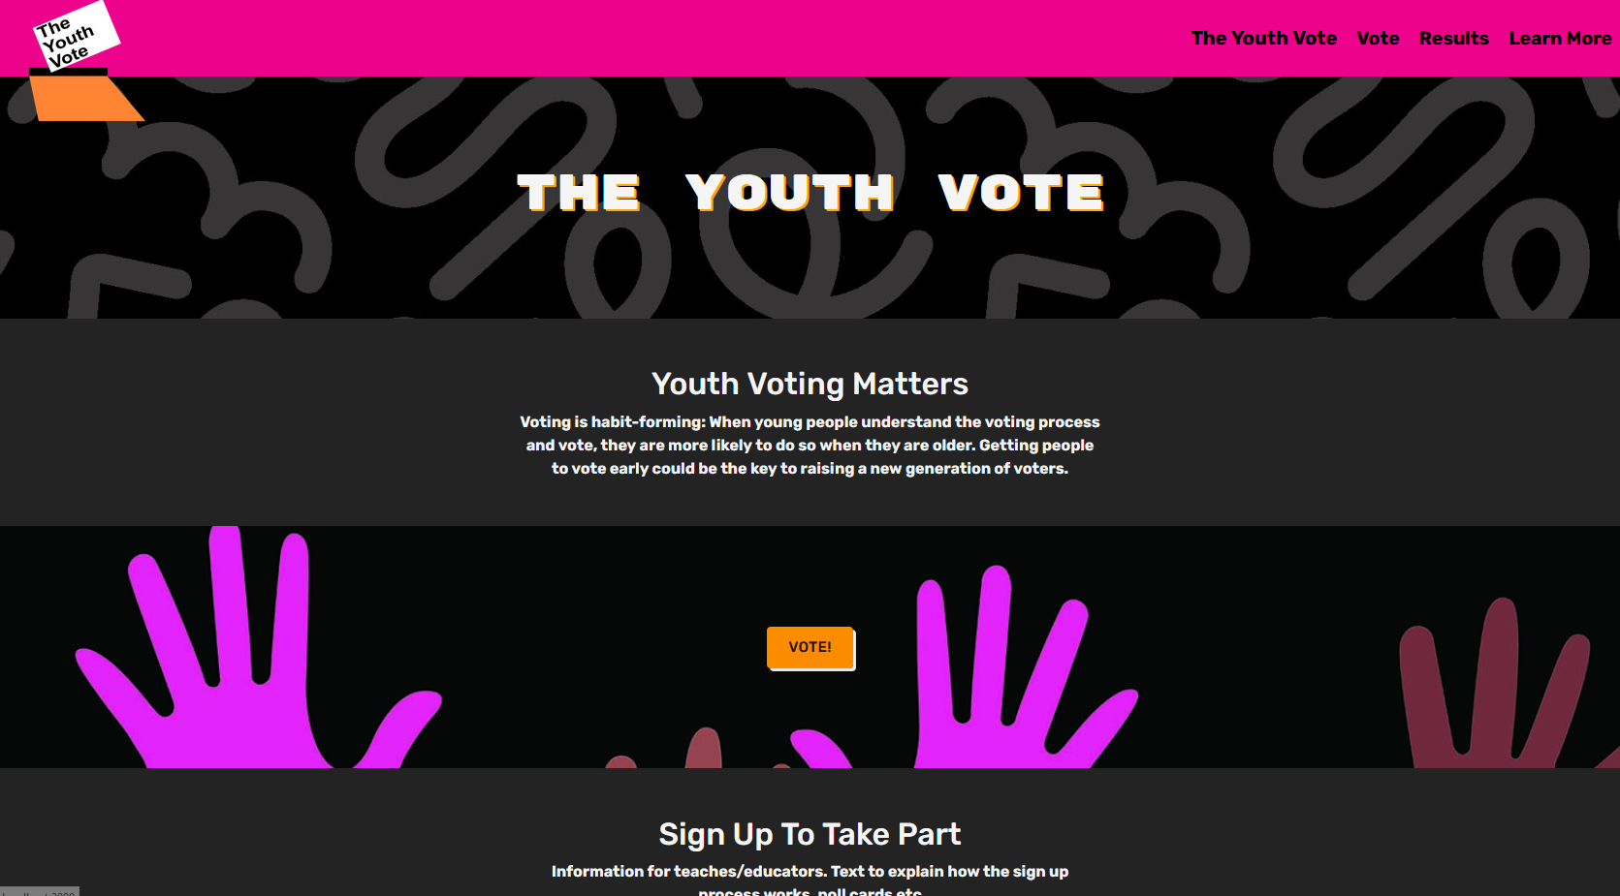
Video link Homepage
Responsive

Slide 4
2.
Sign up Journey

Slide 5
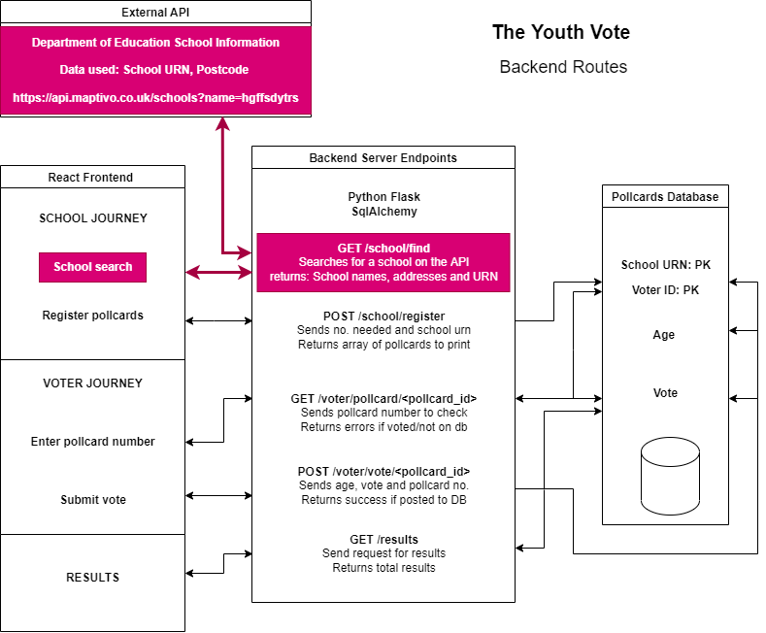
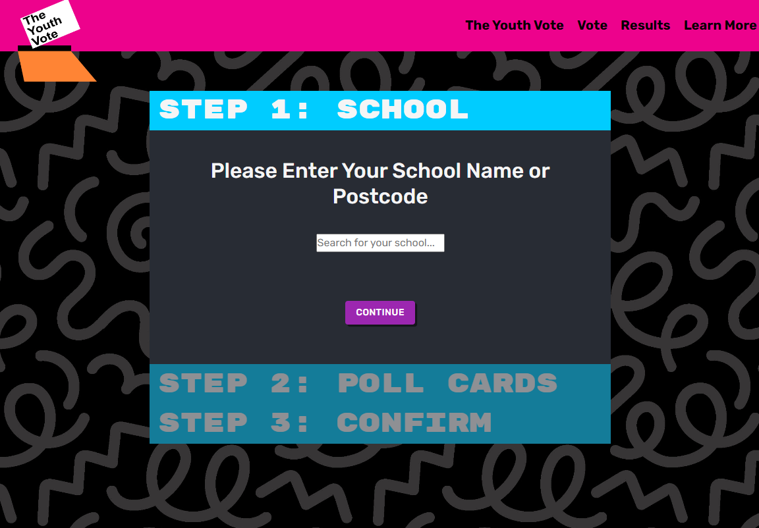

Sign up
journey
Video link Sign-up journey

Slide 6
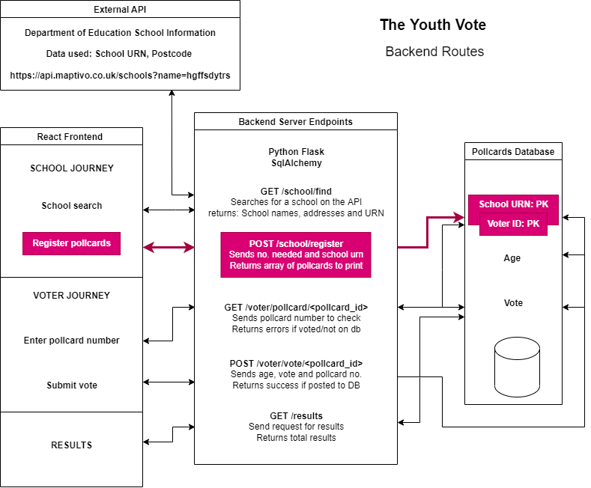


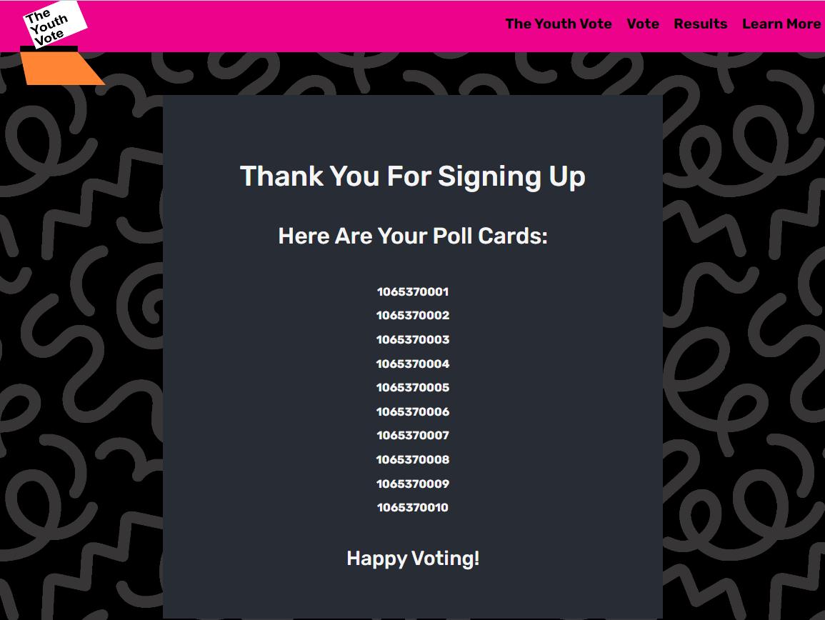
Sign up
journey
Video link Sign-up journey

Slide 7
3.
VOTER Journey

Slide 8
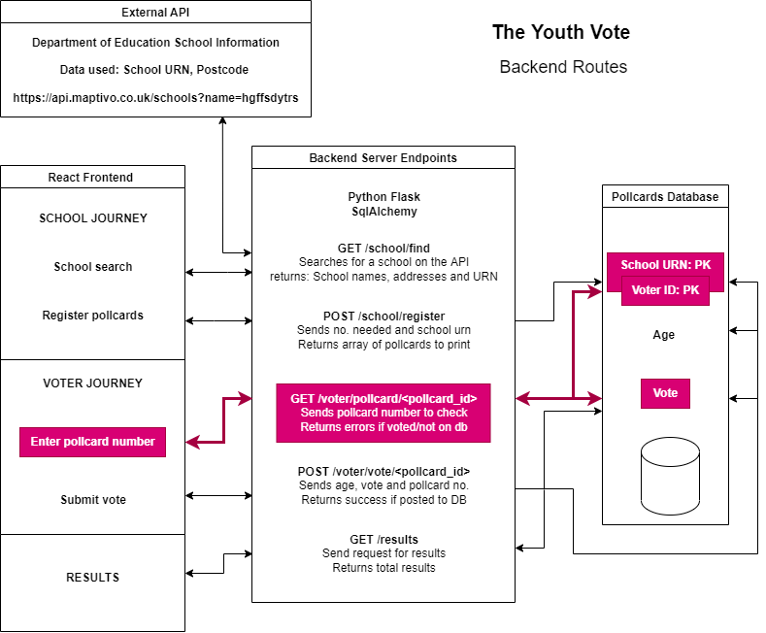
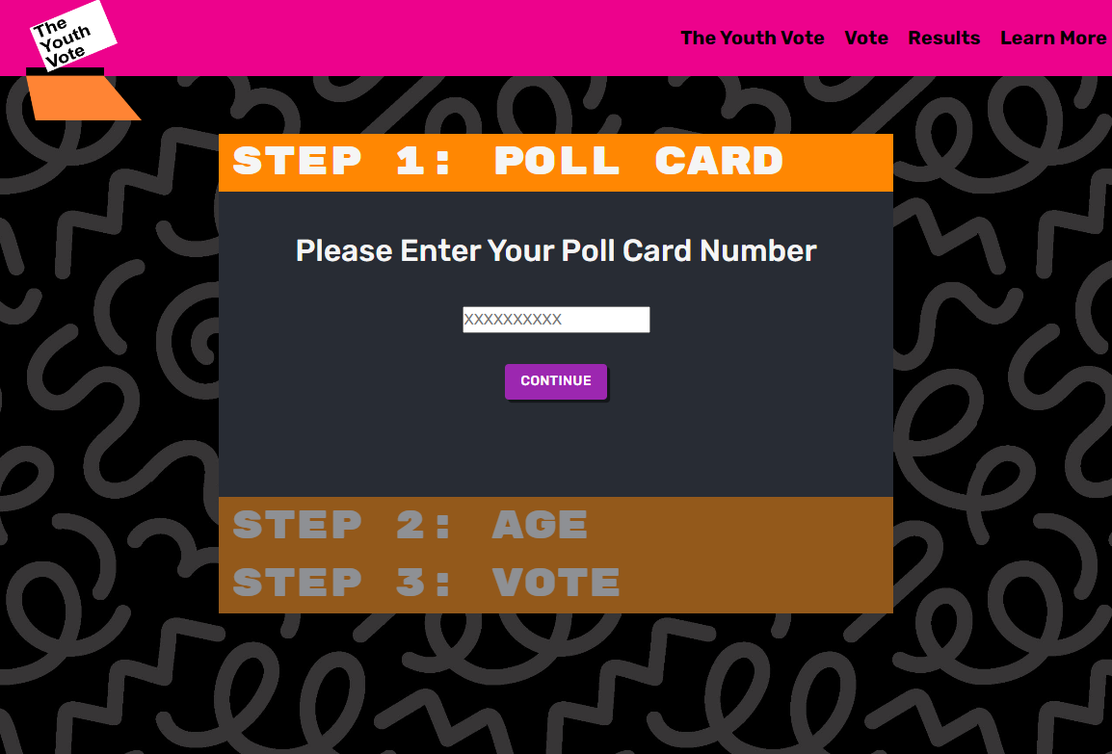
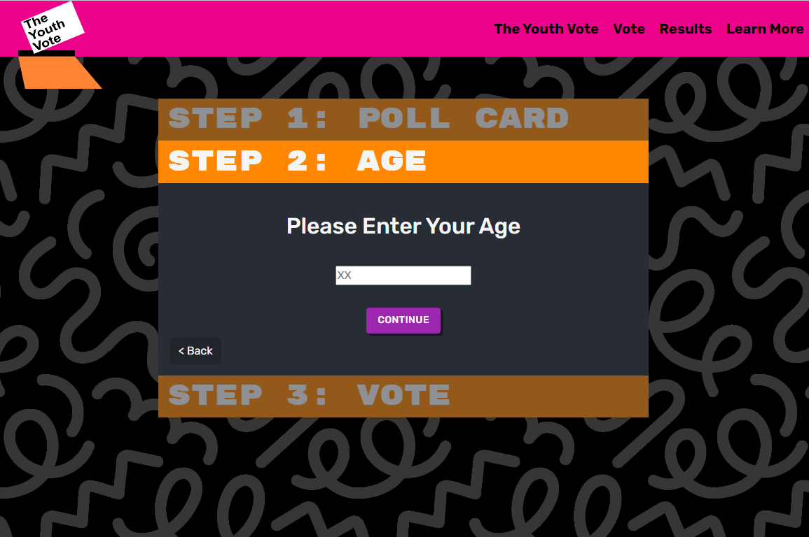
Vote
journey
Video link Voter journey

Slide 9
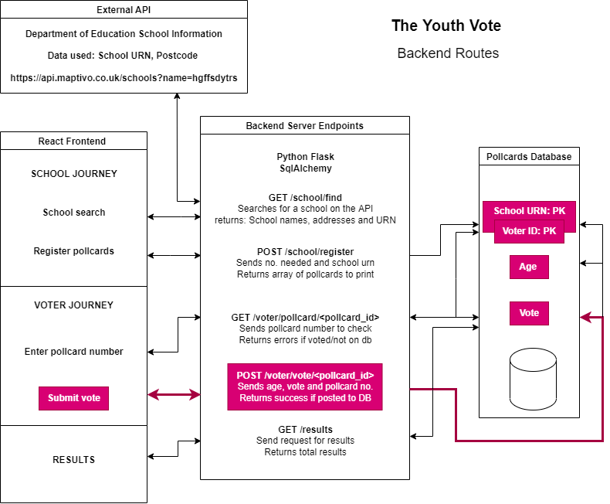
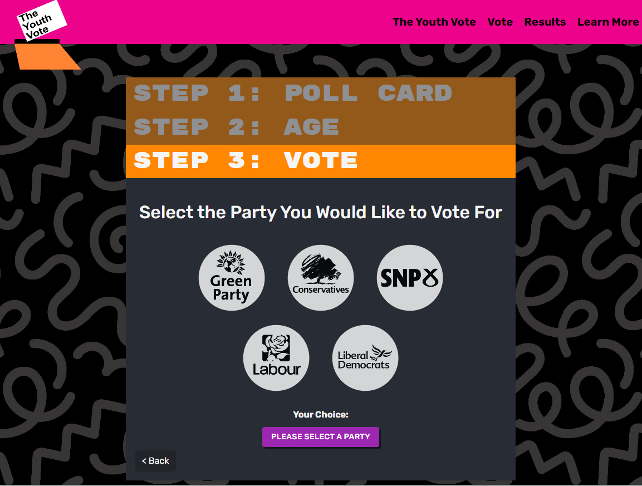
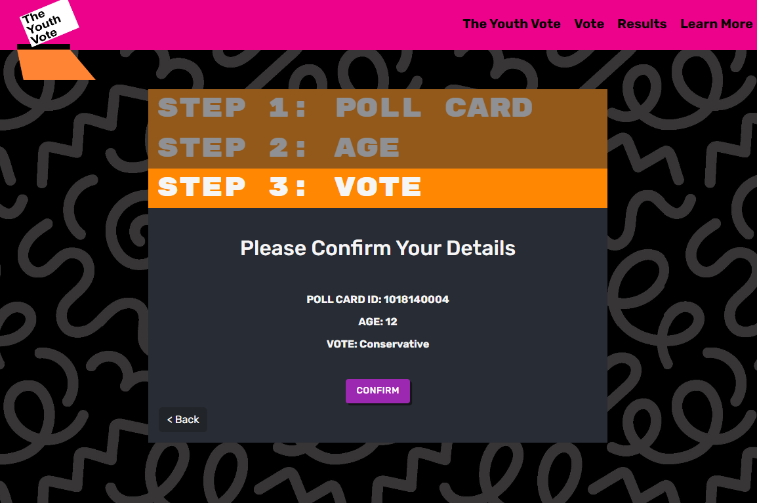

Vote
journey
Video link Voter journey

Slide 10
4.
Results PAGE

Slide 11
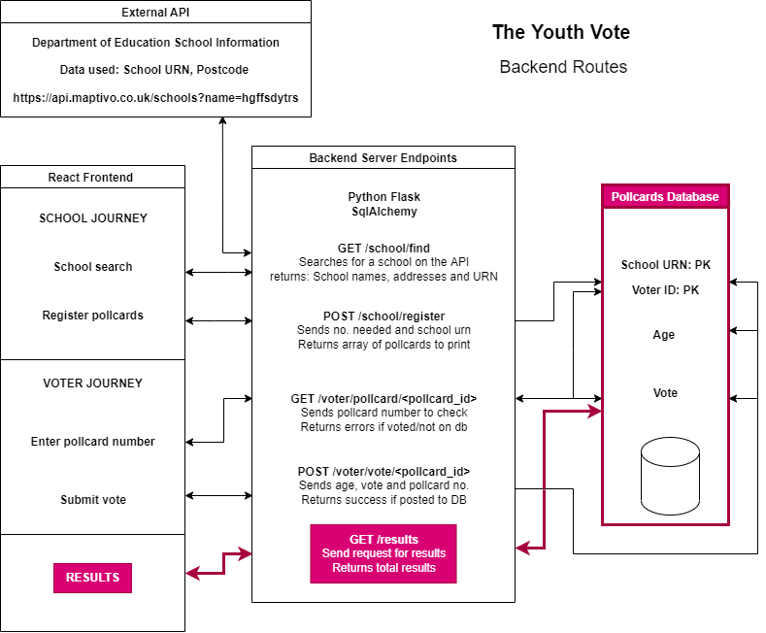
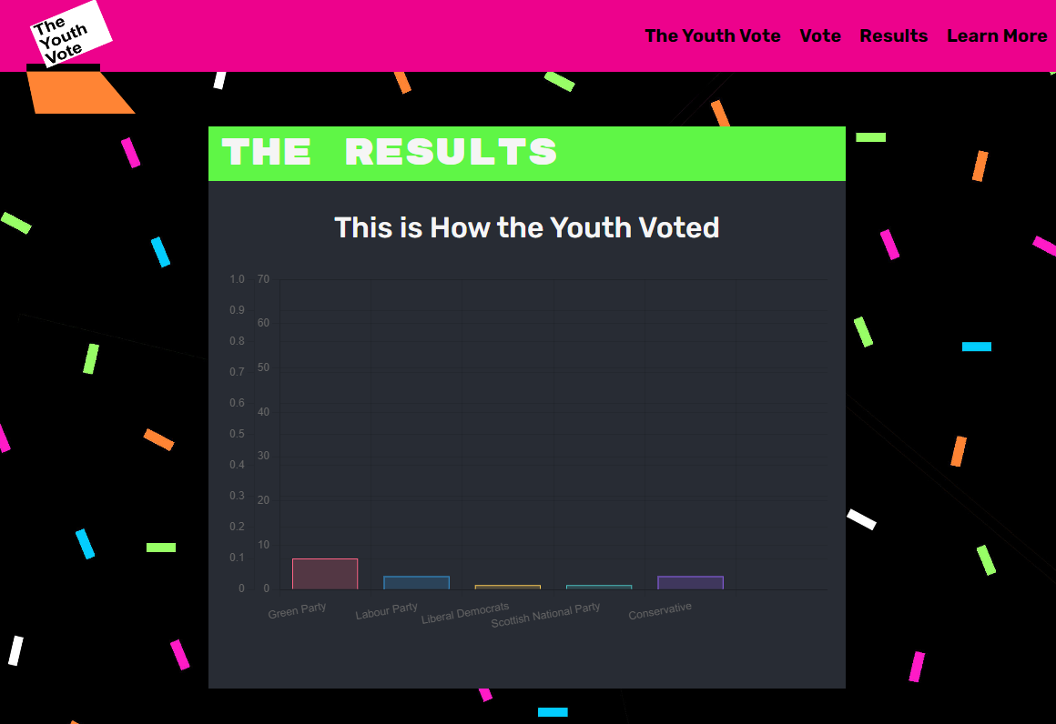
Results
Video link Results

Slide 12
Thank you
Do you have any questions?
Don’t forget to vote!

